Slide 1
Use of a Response-Adapted Ruxolitinib-Containing Regimen for the Treatment of Hemophagocytic Lymphohistiocytosis
HLHRUXO

Slide 2

HLHRUXO Team
Kim Nichols
Co-Study Chair
Kristen Ryan
Study Manager
Melissa Hines
Study Chair
James Sparks
Study Monitor
Sara Grace Hastings
NACHO Coordinator
Notes:
The HLHRUXO team is based out of St Jude Children’s research hospital in Memphis, TN

Slide 3
HLHRUXO Sites
Notes:
There are 10 sites for HLHRUXO

Slide 4
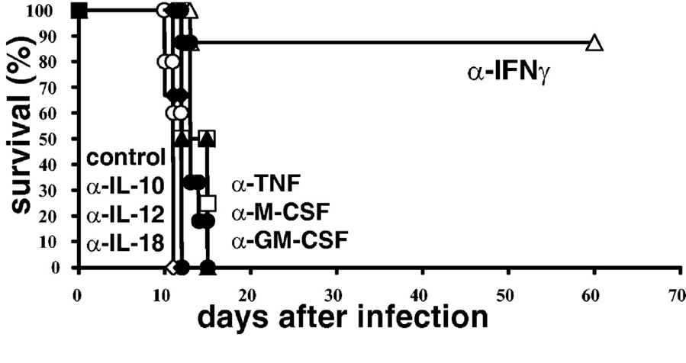
What do we know about HLH pathophysiology?
INF-gamma is a crucial cytokine for the pathophysiology of HLH
  Critical mediator of HLH-associated cytopenias
  Blockade of IFNg ⬇’s anemia and prolongs survival
BUT there are many other cytokines that are drivers of HLH
  Prf1-/- Ifng-/- mice still die following LCMV infection
  Anti-TNFa, not anti-IFNg, protects Prf1-/- mice from MCMV
Notes:
Much of what we know about HLH is from murine models.

Slide 5
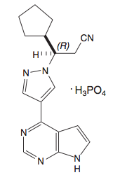
Why Ruxolitinib?
Potent, reversible inhibitor of JAK1/2
  Through this function it inhibits
  signaling of multiple cytokines
Oral, excellent bioavailability
Short half life, no accumulation
  Allows for dose titration
Target HLH via distinct mechanisms
  Synergy with current agents
  Allow for dose reductions
FDA approved, defined toxicity profile
Notes:
To address this question, we chose to examine the effects of ruxolitinib, which is an…
Therefore, it should be possible to identify a dose of ruxolitinib that does not completely abrogate JAK function, but allows for a
residual degree of cytokine signaling. This residual activity could minimize immune suppression and the subsequent risk for infection.
Ruxolitiib may target HLHs in a manner distinct from currently used medications. Therefore, it holds potential to
synergize with traditional HLH-directed agents, such as steroids and/or etoposide, to more effectively treat the disease.
Treatment with ruxolitinib might allow for reductions in the dose of steroids and/or chemotherapy, which
could minimize the chances for immunosuppressive or genotoxic side effects from these agents.
Finally, Ruxolitinib is FDA approved for the treatment of myeloproliferative neoplasms and steroid refractory graft-vs.-host-disease (GVHD), where it has shown to induce responses, even in those with the most advanced disease. Through these and related studies, its toxicity profile has been very well defined for both adults and for children.

Slide 6
Synergy with HLH-Directed Therapies
In addition to inhibition of cytokine signalling ruxolitinib sensitizes cells to dexamethasone-induced cell death by inhibiting pSTAT5 phosphorylation
Normal response to DEX
Cytokine inhibition of DEX
RUX restores DEX response
Notes:
IL-2 and IL_12 confer dexamethasone resistance.

Slide 7
Trial Objectives
Repurpose Ruxolitnib for treatment of HLH as frontline and salvage therapy
Trial a response-adapted therapy for HLH

Slide 8
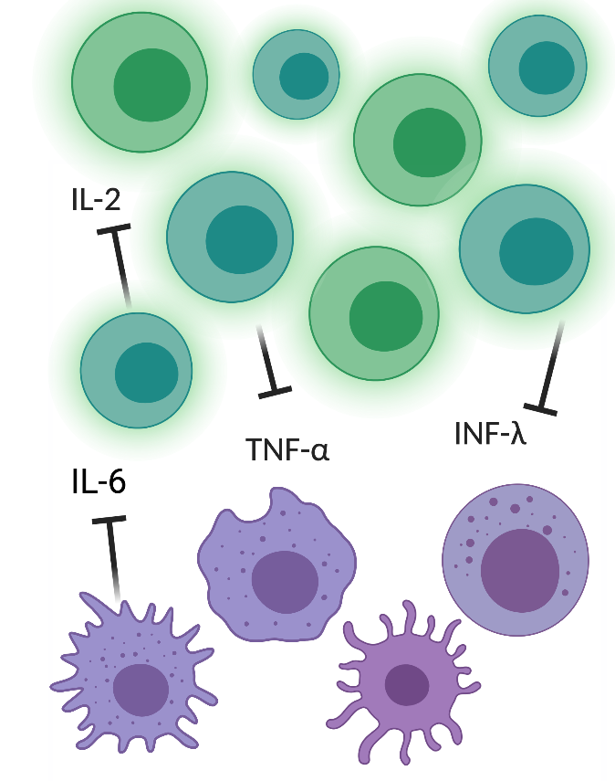

HLHRUXO Building Blocks
Treat Trigger
Ruxolitinib
Inhibition of multiple key cytokines
Steroids
Tcell Apoptosis
Etoposide
Tcell Ablation
Synergistic Effect
Notes:
Steroids=general immune suppression
Etoposide is added as needed to induce additional T cell death

Slide 9
Trial Design
Frontline Arm
Safety Phase
6-12 patients
Frontline Arm Expansion Phase
30 patients
Salvage Phase
20 patients
Notes:
Safety phase for dose verification for the Frontline Arm

Slide 10
HLH-94 Therapy

Slide 11
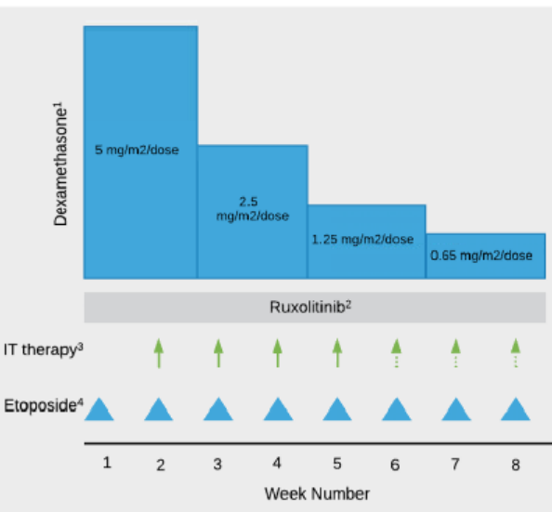
HLHRUXO Frontline Safety Phase Therapy
Patients are started on all 3 drugs up front.
  Etoposide
  Ruxolitinib
  Dexamethasone
If complete response after 4 weeks, etoposide can be held
Notes:
Similar to HLH-94 this protocol is set up with 8 week initiation therapy to be followed by continuation therapy as needed if patient needs to go to HSCT

Slide 12
HLHRUXO Frontline Expansion Phase and Salvage Arm
Patients are started on 2 drugs
  Ruxolitinib
  Dexamethasone
Etoposide added based on response to therapy

Slide 13
General Inclusion Criteria
Age: >6 weeks and < 22 years Evidence of active disease Weight > 3kg Salvage: must have failed previous therapy
Allowed Previous Therapy for Frontline | Required Previous Therapy for Salvage
Steroids up to 2 weeks Anakinra | At least 2 weeks of steroids AND at least 2 doses of etoposide OR at least 1 dose of ATG NOTE: Must be 7 days between last dose of etoposide/ATG and starting ruxolitinib
Note: we are not currently enrolling < 6 months of age
Notes:
Patients <6m cannot enroll until 3 safety phase patients older than 6m complete the first 8 weeks of treatment and the DSMC evaluates the data.

Slide 14
Evidence of Active Disease for Frontline | Evidence of Active Disease for Salvage
≥5 of 8 HLH-2004 Diagnostic Criteria Fever Splenomegaly Cytopenias affecting ≥2 of 3 cell lineages Hypertriglyceridemia (≥265 mg/dL) OR hypofibrinogenemia (≤150 g/dL) Presence of hemophagocytosis Low or absent NK-cell activity OR decreased CD107a mobilization Ferritin ≥500 ng/mL Soluble IL-2 receptor (CD25) ≥2400 U/mL OR ≥4 of the HLH-2004 Diagnostic Criteria with known familial HLH (known genetic defect) | 3 or more Relapsed/Refractory HLH Criteria: Fever Splenomegaly (recurrent or worsening) Neutrophils <1000 × 10⁶/L × 2 assessments over at least 3 days OR platelets <100 × 10⁹/L × 2 assessments over at least 3 days, OR need for platelet transfusions Hypofibrinogenemia (fibrinogen <150 g/dL) Soluble IL-2 receptor level ≥ 2400 U/L Evidence of new or worsening CNS Disease (clinical, CSF testing, MRI findings) Presence of hemophagocytosis Increasing ferritin × 2 assessments over at least 3 days (both levels must be >2000 ng/dL)
Notes:
Does my patient still meet inclusion criteria if some of the symptoms of HLH resolve between time of reservation or screening and enrollment?
Per the protocol, “Eligibility criteria must be met within 7 days of initial screening to be considered for inclusion in the study.” This means that the patient must meet the inclusion criteria at enrollment or within the last 7 days prior to enrollment.
The preference is that the patient continue to meet as many criteria as possible on the day of the enrollment, but some HLH findings may come and go. For the eligibility checklist, please document as many criteria as possible that are met on the day of enrollment. For those criteria that are not met on the day of enrollment, please note the day that the patient met criteria as a comment in TM.
The most common criteria that may not be present on the day of enrollment are fever and cytopenias.
Fever may be intermittent, especially if the patient has been on steroids and is receiving scheduled antipyretics. If patient is not febrile on the day of enrollment but has been febrile in the last week, please document that the patient met criteria for fever and the date of the fever.
Often patients may receive transfusions for anemia and thrombocytopenia. If the patient no longer meets cytopenia criteria due to recent transfusion, please note the hemoglobin or platelet count that meets criteria, and that patient did receive transfusion.

Slide 15
Exclusion Criteria
Isolated CNS disease Malignancy Rheumatologic disease Previous HCT for indication other than HLH Suspected or known fungal disease | Severe organ dysfunction: Severe renal failure and patient unable to tolerate HD or CRRT Severe liver failure (ALT>1000); CV failure requiring pressors; resp failure requiring PPV
Frontline Previous Therapy Exclusion | Salvage Previous Therapy Exclusion
Patient has received any prior treatment with any JAK inhibitor, ATG, alemtuzumab, etoposide, tocilizumab OR emapalumab. | Patient has received prior treatment with any JAK inhibitor, tocilizumab, alemtuzumab, OR emapalumab within the last 3 months. NOTE: Wash out period of 7 days between last dose of etoposide/ATG and starting ruxolitinib

Slide 16
Questions??
Email the team:
HLHRUXO@stjude.org

